Slide 1




A Complete Guide to Programming in C++
Chapter 17 – Arrays and Pointers

Slide 2
Arrays and Pointers
This chapter describes the relationship between pointers and arrays.
This includes:
pointer arithmetic
pointer version of functions
pointers as return values and read-only pointers
pointer arrays
Operations that use C strings illustrate how to use pointers for efficient programming. String access via the command line of an application program is used to illustrate pointer arrays.

Slide 3

Arrays and Pointers
In C++ the name of an array is also the starting address for that array. To be more precise, an array name is a pointer to the first array element.
In this case, town is a char pointer to town[0], that is, a pointer to the memory address that stores the 'B' character. Expressions town and &town[0] are thus equivalent.

Slide 4


Pointer Variables and Arrays
An array name is not a pointer variable but a constant that cannot be modified. However, you can assign this constant to a pointer variable
Now cPtr points to the array element town[0] just like town. But, in contrast to town, cPtr is a variable that can be moved.
After this statement, cPtr points to the ‘H' character. String constants such as “Hello!" are also char arrays and thus represent the address of the first array element.

Slide 5

Typeless Pointers
If you need to display the address rather than the string, you should pass a void* type pointer rather than a char pointer.
This casts the char pointer to a void * type pointer and passes it as an argument to the << operator, which in turn outputs the address in hexadecimal format. The << operator belongs to the ostream class and is overloaded for void * types for this purpose.
A void * pointer represents a memory address without establishing a certain type. void * pointers are also referred to as typeless pointers for this reason. When you use a typeless pointer for memory access, you must therefore name the type being accessed explicitly by means of type casting.
EXAMPLE: Using arrays of char and pointers to char

Slide 6
Addressing Array Elements
Access to individual array elements in C++ is very closely related to pointer arithmetic. Now let’s look at an int array to illustrate this point.
As you already know, the name of the array arr is an int pointer to arr[0].
Now it is possible to add or subtract pointers and integral values. The size of the object referenced by the pointer is automatically taken into consideration.

Slide 7
Addressing Array Elements
Since arr is an int pointer to arr[0], arr+1 points to the next array element arr[1], i.e., to an address that is sizeof(int) bytes higher in memory. The memory space between the two entries will be two or four bytes, depending on the size of the type int.
Thus the following applies to any given number, i:
arr + i points to the array element arr[i]
*(arr + i) is the array element arr[i]
This technique can also be used to address memory spaces outside of the array. Thus, arr - 1 addresses the word that precedes arr[0]. But generally this does not make much sense, since you have no means of knowing what is stored at this memory address.

Slide 8
Addressing with Pointer Variables
Array elements can also be addressed using pointer variables.
In this case, both ptr and arr are pointers to the array element arr[0]. Thus, ptr + 1, ptr + 2, . . . point to the array elements arr[1], arr[2], ... . For any given integer, i, the following expressions are thus equivalent:
The following thus represent equivalent values:
At first it might seem surprising that you can use the array notation ptr[i] for pointers. The compiler translates arr[i] to *(arr + i)—in other words: “Start at address arr, move i objects up, and access the object!” This also applies to ptr[i]

Slide 9

Pointer arithmetic
In C++ you can perform arithmetic operations and comparisons with pointers, provided they make sense. This primarily means that the pointer must always point to the elements of an array. The following examples show some of your options with pointer arithmetic:

Slide 10
Moving a Pointer in an Array
As you already know, the addition pv + i results in a pointer to the array element v[i]. You can use a statement such as pv = pv + i; to store the pointer in the variable pv. This moves the pointer pv i objects, that is, pv now points to v[i].
You can also use the operators ++, --, and += or -= with pointer variables. Some examples are shown opposite. Please note that the indirection operator, *, and the operators ++ and -- have the same precedence. Operators and operands thus are grouped from right to left:
The ++ operator increments the pointer and not the variable referenced by the pointer. Operations of this type are not possible using the pointer v since v is a constant

Slide 11
Subtracting Pointers
An addition performed with two pointers does not return anything useful and is therefore invalid. However, it does make sense to perform a subtraction with two pointers, resulting in an int value that represents the number of array elements between the pointers. You can use this technique to compute the index of an array element referenced by a pointer. To do so, you simply subtract the starting address of the array. For example, if pv points to the array element v[3], you can use the following statement
to assign a value of 3 to the variable index.

Slide 12

Comparing Pointers
Finally, comparisons can be performed with two pointers of the same type.
This loop outputs the numbers contained in v in reverse order

Slide 13
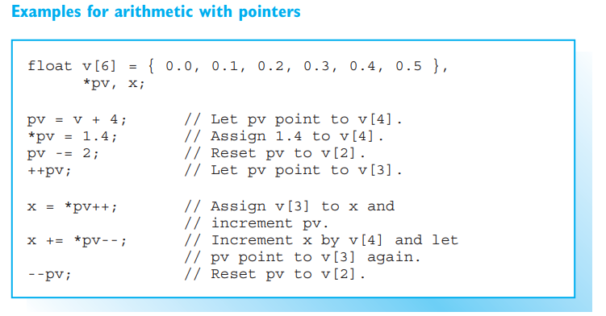

Slide 14
Arrays as arguments
If an array name is passed as an argument when calling a function, the function actually receives the address of the first array element. The called function can then perform read or write operations for any element in the array.
If the argument is an array, there are two equivalent methods of declaring parameters. This point is illustrated by the EXAMPLE using strlen() to return the length of a C string. For example, calling strlen("REGAL") returns a value of 5.
EXAMPLE: Defines and calls the function reverse().

Slide 15
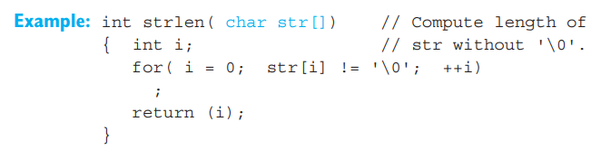

Arrays as arguments
1. You can declare the parameter as an array.
2. You can declare the parameter as a pointer.

Slide 16
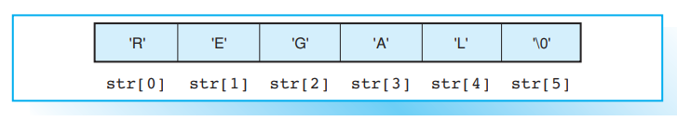
Arrays as arguments
In both cases the parameter str is a pointer that stores the starting address of the array. Array notation is preferable if you intend to use an index to access the elements of an array. Calling strlen("REGAL"); leads to the following situation:
As you can see, the length of a C string is equal to the index of the element containing the terminating null character.
The function reverse() in the EXAMPLE copies the characters of a C string to a second char array in reverse order, first copying the last character in s1, that is, the character with the index strlen(s1)-1, to s2[0], then the second to last character s2[1], and so on.

Slide 17
Array Length
A function to which an array is passed initially knows only the starting address of the array but not its length. In the case of C strings, the length is derived implicitly from the position of the terminating null character. In most other cases the length must be supplied explicitly.

Slide 18

Function strcpy
The standard function strcpy()copies C strings.
Here the string source is copied to dest “from left to right” just like an assignment.

Slide 19
Using Pointers Instead of Indices
As we have already seen, a parameter for an array argument is always a pointer to the first array element. When declaring parameters for a given type T:
So far, in previous sample functions, the pointer has been used like a fixed base address for the array, with an index being used to access the individual array elements. However, it is possible to use pointers instead of indices.

Slide 20
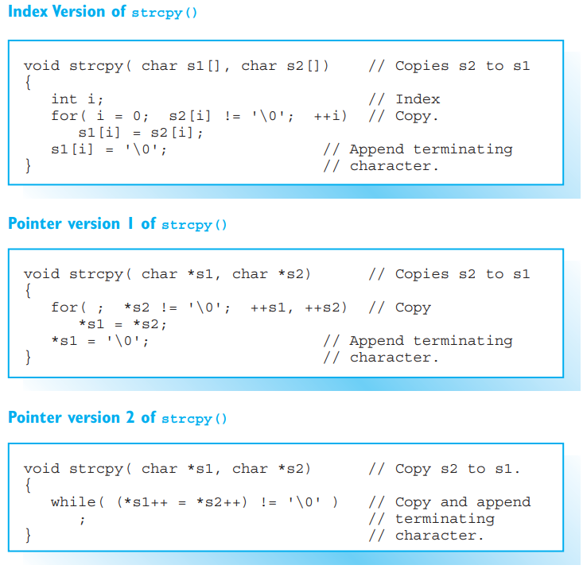

The first version of the function strcpy() “string copy” uses an index, whereas the second does not. Both versions produce the same results: the string s2 is copied to s1. When you call the function, you must ensure that the char array referenced by s1 is large enough.
As the parameters s1 and s2 are pointer variables, they can be shifted. The second “pointer version” of strcpy(), which is also shown opposite, uses this feature, although the function interface remains unchanged.
Generally, pointer versions are preferable to index versions as they are quicker. In an expression such as s1[i] the values of the variables s1 and i are read and added to compute the address of the current object, whereas s1 in the pointer version already contains the required address.

Slide 21
Read-Only Pointers
Pointers to const Objects
You can use a normal pointer for both read and write access to an object. However, just like the definition used for a reference, you can also define a read-only pointer, that is, a pointer that can be used for read operations only. In fact, a read-only pointer is obligatory if you need to point to a constant object.
You use the keyword const to define a read-only pointer.
This statement defines the constants a and b, and a pointer p to a constant object of type int. The referenced object *p can be read but not modified.

Slide 22


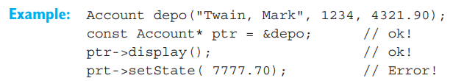
Pointers to const Objects
The pointer itself is not a constant, so it can be modified:
The referenced object also does not need to be a constant. In other words, a read-only pointer can also point to a non-constant object.
.

Slide 23
Read-Only Pointers as Parameters
Read-only pointers are most commonly found in parameter lists. This guarantees that arguments cannot be modified.
In this example, the parameter s is a read-only pointer. This allows you to pass constant C strings to the standard function strlen(). You cannot remove the “write protection” by assigning the read-only pointer s to a normal pointer.
You need to declare a read-only pointer if a constant object may be passed as an argument.

Slide 24
Returning pointers
A function can return a pointer to an object. This makes sense for a function that searches for a particular object, for example. Such a function will return either a pointer to the required object or a NULL pointer if the object cannot be found.
The standard C library functions often use pointers as return values. For example, the functions strcpy(), strcat(), and strstr() each return a pointer to the first character in a C string.

Slide 25
Arrays of pointers
Pointers offer various possibilities for simple and efficient handling of large amounts of data. For example, when you are sorting objects it makes sense to define pointers to those objects and simply place the pointers in order, instead of rearranging the actual order of the objects in memory.
Whenever you need a large number of pointers, you can define an array whose elements are pointers. An array of this type is referred to as a pointer array.

Slide 26
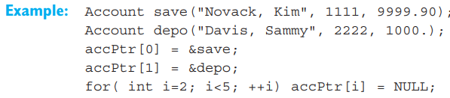
Arrays of pointers
The array accPtr contains five Account pointers accPtr[0], accPtr[1], ... , accPtr[4]. The individual pointers in the array can now be assigned object addresses. Any pointers not currently in use should have the value NULL.

Slide 27
Command Line Arguments
When you launch a program, you can use the command line to supply additional character sequences other than the program name. These command line arguments are typically used to govern how a program is executed or to supply the data a program will work with.
In this case, the program copy is launched with the arguments file1 and file2. The individual arguments are separated by spaces. Characters used for redirecting input and output ( > or < ) and a following word are evaluated by the operating system and not passed to the program. If an argument contains space or redirection characters, you must place it in double quotes.

Slide 28

Parameters of the Function main()
So far we have only used the function main() without parameters. However, if you intend to process command line arguments, you must define parameters for main().

Slide 29
Parameters of the Function main()
argc contains the number of arguments passed via the command line. The program name is one of these, so argc will have a value of at least 1.
The parameter argv is an array of char pointers:
argv[0] points to the program name (and path)
argv[1] points to the first real argument, that is, the word after the program name
argv[2] points to the second argument
argv[argc-1] points to the last argument
argv[argc] is the NULL pointer
The parameters are traditionally named argc and argv although any other name could be used. Various operating systems, for example WINDOWS 98/00/NT and UNIX, allow you to declare a third parameter for main(). This parameter is an array with pointers to environment strings.
EXAMPLE: Demonstrates the command line arguments.

